Slide 1
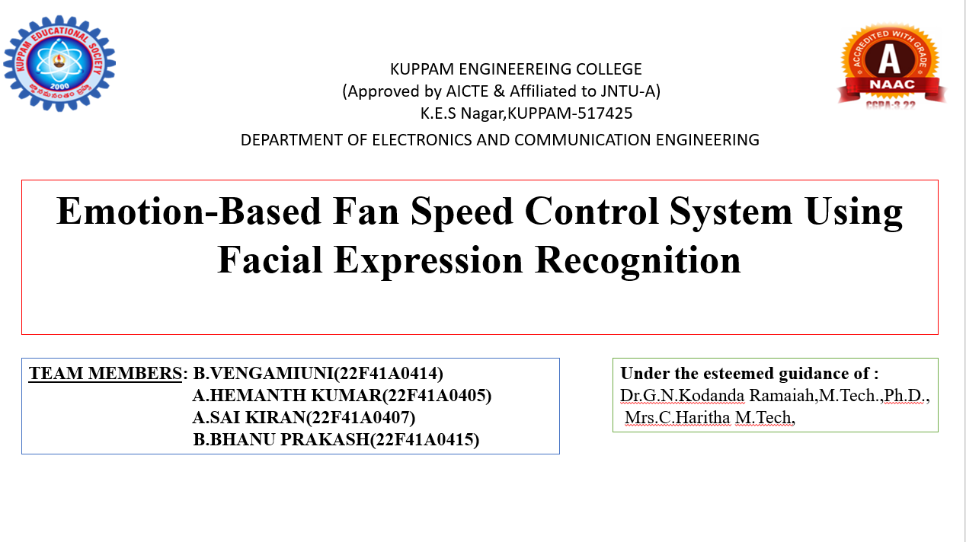

Slide 2
Introduction
Automation is making modern systems more intelligent and responsive to human needs.
This project presents an emotion-based fan speed control system that uses facial expression recognition to operate a fan automatically.
A camera captures the user’s face, Python detects the emotion, and Arduino adjusts the fan speed with LED indication.
The system creates a simple link between human emotion and appliance control, improving comfort and making the setup more interactive.

Slide 3
Problem Identification
Traditional fan systems work only with manual control and cannot understand the user’s emotional state.
This creates inconvenience because the fan speed does not adjust automatically according to the person’s mood.
To overcome this, the proposed system detects facial emotion using a camera and Python code, then controls the fan speed and LED indication automatically.

Slide 4
Objectives
To detect human emotions using facial expressions.
To process emotions using Python.
To control fan speed automatically based on emotion.
To interface with Arduino for hardware control.
To display system status using LEDs/LCD.

Slide 5
Literature Survey
S.no | Author | Title | Problem | Summary
1 | Hadjar, H., et al. | TheraSense | Difficult to detect emotion accurately in real time from video. | Proposed a deep learning system for real-time facial emotion recognition in teleconsultation.
2 | Bai, M., et al. | Lightweight Emotion Analysis Solution Using TinyML | Existing models are too heavy for embedded devices. | Developed a lightweight TinyML model for facial emotion recognition on portable devices.
3 | Sone, Y., et al. | Control Support System for Smart Homes | Smart homes lack personalized automatic control. | Presented an intelligent smart home control system based on user-interest analysis.
4 | Addow, M. A., et al. | Low-Cost IoT-Based Smart Home Automation System | Smart automation is often costly. | Designed a low-cost IoT system for appliance automation and monitoring.
5 | Aleran, A., et al. | AI and IoT in Energy Preservation | Energy wastage remains high in automated systems. | Reviewed how AI and IoT improve energy-efficient appliance control.

Slide 6
Existing System
In the existing system, fan speed is controlled manually using switches or regulators. Some automatic systems use temperature sensors or timer-based control, but they do not consider the user’s emotional condition. These systems only respond to fixed inputs and cannot provide personalized comfort.
Disadvantages of Existing System:
Requires manual operation
No emotion recognition capability
Cannot provide personalized control
Less intelligent and less interactive
May lead to unnecessary power usage
Does not improve user comfort based on mood

Slide 7
Proposed System
The proposed system uses a camera to capture the user’s facial expression in real time.
The captured image is processed using Python-based emotion detection to identify emotions such as anger, happy, and sad. The detected emotion is then sent to the Arduino Uno, which acts as the main control unit.
Based on the emotion received, the Arduino controls the fan speed through a motor driver and turns ON the corresponding LED indicator.
In this system, anger makes the fan run at high speed with red LED ON, sad makes the fan run at medium speed with yellow LED ON, and happy keeps the fan OFF with green LED ON.
The LCD display shows the detected emotion and current system status, making the system smart, automatic, and user-friendly.

Slide 8
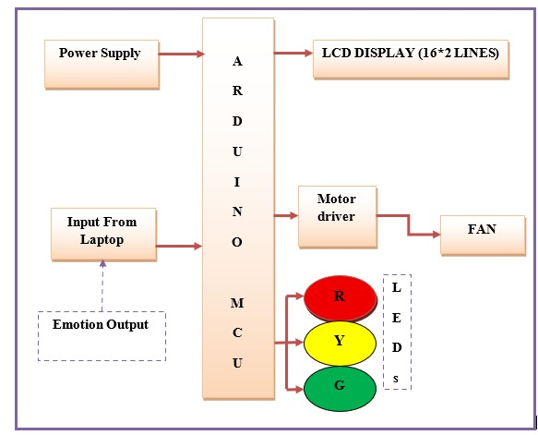
Block Diagram

Slide 9
Operation
The system starts by capturing the user’s face through a camera. The facial image is processed in Python to detect the current emotion.
Based on the detected result, a signal is sent to the Arduino Uno. The Arduino then controls the fan speed and LED indication accordingly.
If anger is detected, the red LED turns ON and the fan runs at high speed.
If sad is detected, the yellow LED turns ON and the fan runs at medium speed.
If happy is detected, the green LED turns ON and the fan remains OFF. The LCD display shows the detected emotion and system status in real time.

Slide 10
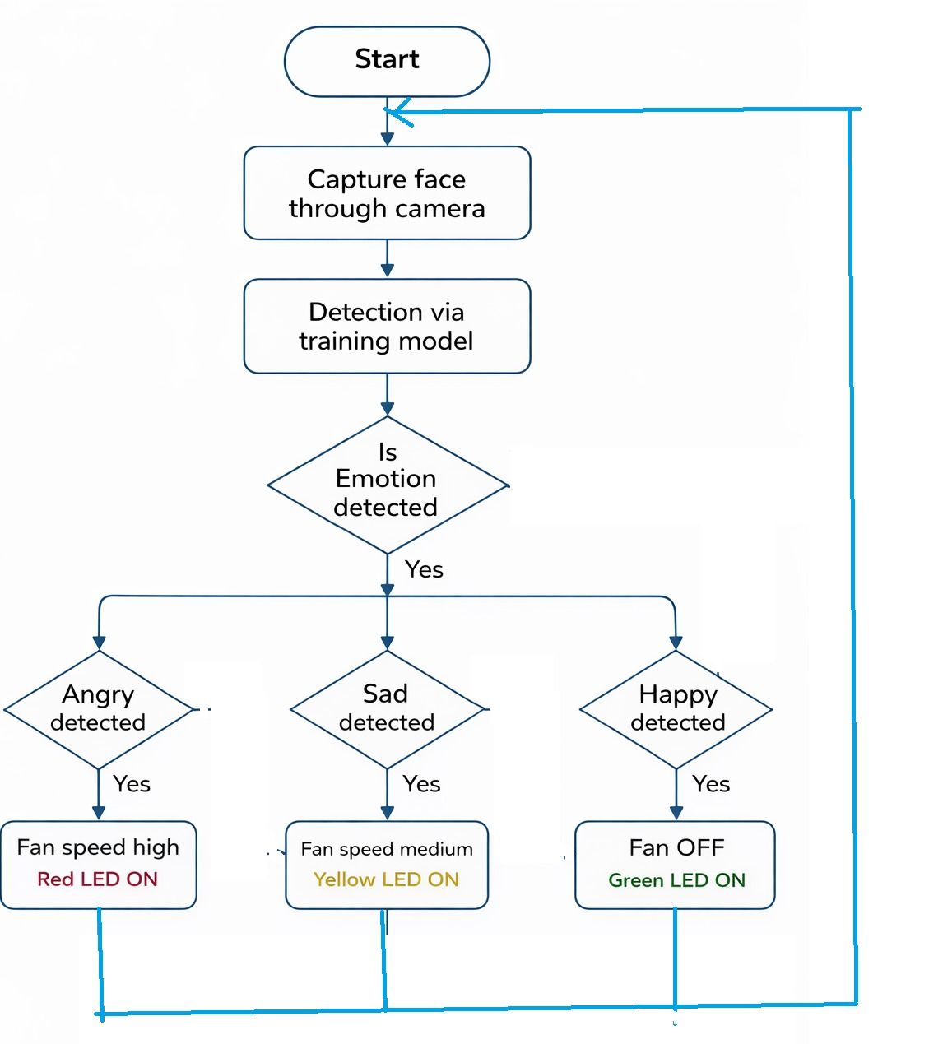
Implementation Flow chart

Slide 11
Hardware Details
Laptop Camera
Laptop Arduino Uno
Motor Driver Module
DC Fan
LCD Display
Red LED
Green LED
Yellow LED
Power Supply
Connecting Wires

Slide 12
Software Details
1.Operating System (Windows/Linux) is used commonly for development.
2.Python (Anaconda) is used for facial emotion recognition and process camera input.
3.OpenCV is used for capture image from webcam and perform face detection.
4.NumPy is used for handles numerical operations.
5.PySerial is used for sends detected emotion &enables communication through USB
6.Emotion Detection Model it is trained AI system that identifies human emotions from facial images .
7.Arduino IDE is used to write and upload code to Arduino Uno,control fan,LEDs .

Slide 13
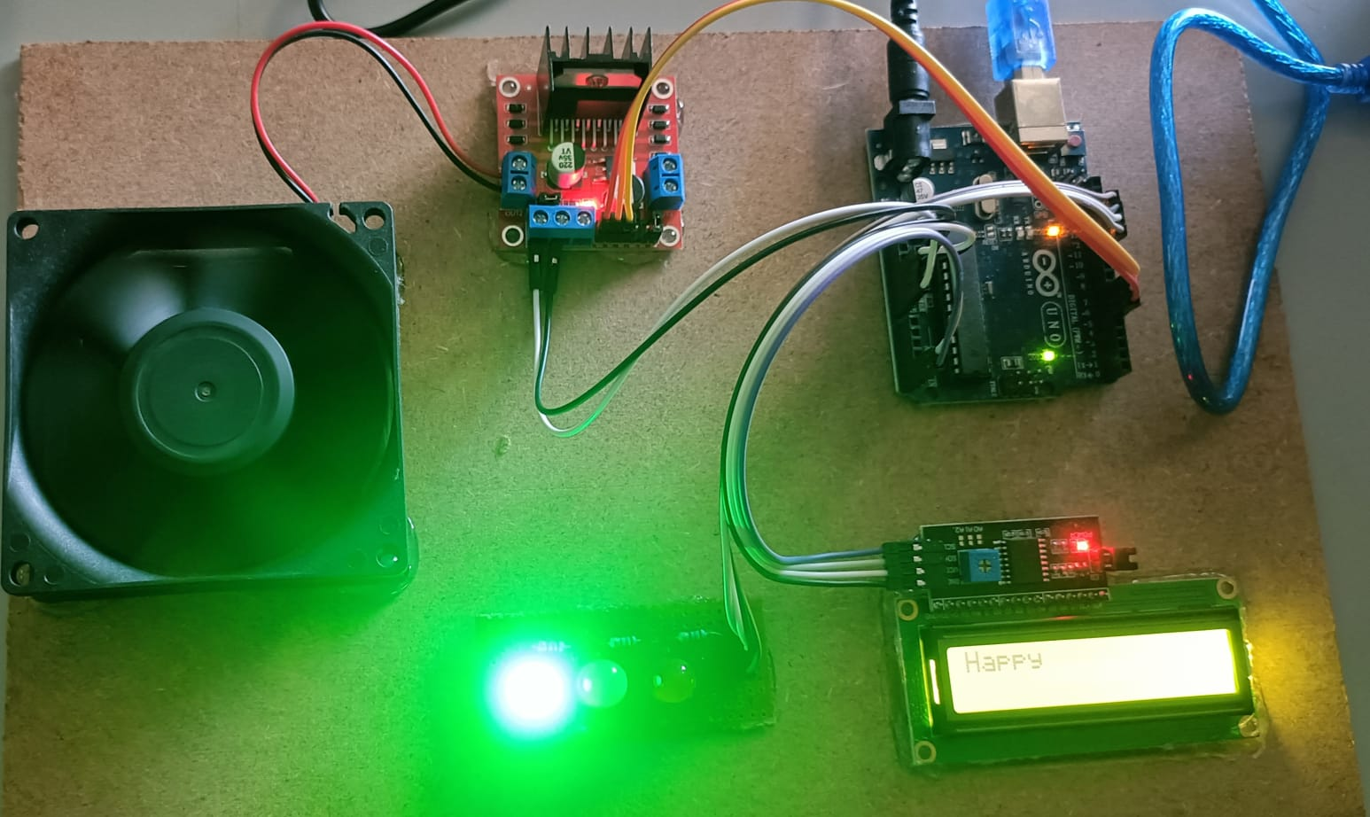
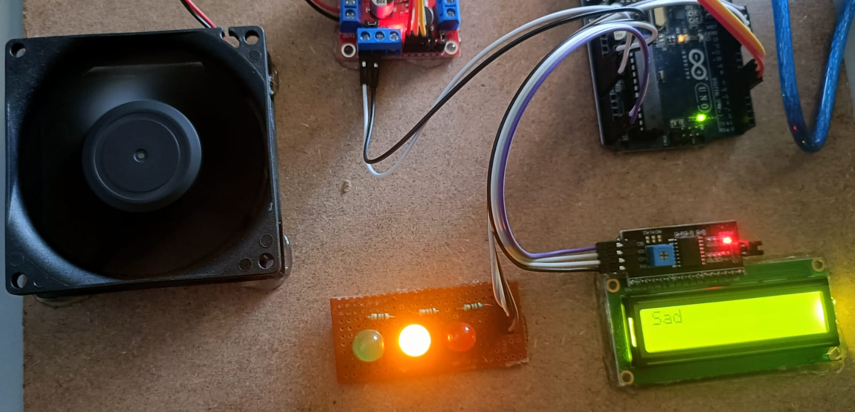
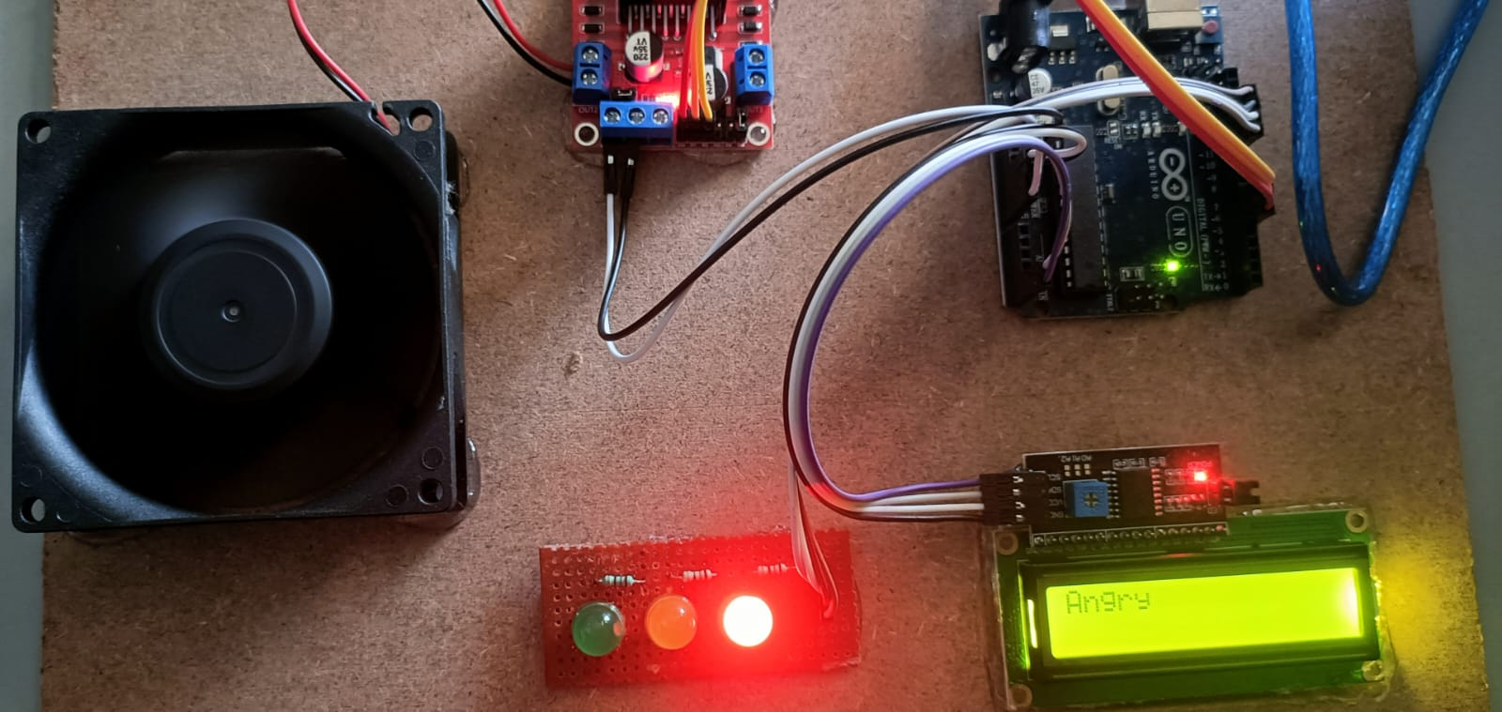

Result & Output

Slide 14
Advantages
Automatic fan speed control
Reduces manual effort
Improves user comfort
Smart and interactive system
Real-time emotion detection
Easy to implement
Low-cost automation setup
Useful for intelligent home applications

Slide 15
Applications
Smart homes
Personal comfort systems
Intelligent room automation
Human-machine interaction systems
Healthcare and patient care rooms
Stress-aware environments
Smart office cabins
Emotion-based appliance control systems

Slide 16
Future scope
In future, the system can be improved by detecting more emotions with higher accuracy. It can be connected to IoT platforms for remote monitoring and control. The project can also be extended to control multiple home appliances such as lights, air conditioners, and alarms based on user emotion. With advanced AI models and better sensors, the system can become more efficient, reliable, and suitable for real-world smart home applications.

Slide 17
Conclusion
The emotion-based fan speed control system provides a smart and automatic way to control fan operation using facial emotion recognition. By combining a camera, Python-based emotion detection, and Arduino control, the system adjusts fan speed based on the user’s emotional state. This improves comfort, reduces manual work, and makes the system more interactive and intelligent. The project shows how emotion recognition can be connected with home automation in a simple and effective way.

Slide 18
References
Hadjar, H., et al. “TheraSense: Deep Learning for Facial Emotion Analysis in Teleconsultation.” Electronics, vol. 14, no. 3, 2025, Article 422.
Bai, M., et al. “Lightweight Emotion Analysis Solution Using Tiny Machine Learning.” Computers & Electrical Engineering, 2025.
Sone, Y., et al. “Development of a Control Support System for Smart Homes.” Robomech Journal, 2025.
Addow, M. A., et al. “A Low-Cost IoT-Based Smart Home Automation System for Urban Environments.” Discover Internet of Things, 2025.
Aleran, A., et al. “Artificial Intelligence and the Internet of Things in Energy Preservation.” Computing, 2025.

Slide 19


